Slide 1
A+
Student Performance Analytics System
Design a MySQL database, then analyse the marks with NumPy and Pandas and present the results with Matplotlib charts and a menu-driven program.
MySQL
Pandas & NumPy
Matplotlib
Python
Submitted by: Krishna Rathod COE BATCH 4
Notes:
Introduce yourself in one line, then the project: student marks are stored in MySQL and analysed with Python.

Slide 2
AGENDA
Roadmap for today
1
2
3
Part A: Database (MySQL)
Part B: Python analysis
Results and demo
ER diagram and 3NF
Tables and constraints
JOIN queries
Stored functions
Load and merge CSV files
NumPy and Pandas analysis
Matplotlib charts
Menu-driven program
Key findings
SQL and Pandas match
Live demo
What I learned
Student Performance Analytics System · Overview
Notes:
Give the big picture: database first, then Python analysis, then results and a live demo.

Slide 3
OVERVIEW
The problem we solve
A college wants to keep the marks of its students in a proper database and analyse them to find toppers, weak subjects and students at risk.
Part A - MySQL
Part B - Python
Data size
Normalized database with 4 tables, constraints, JOIN queries and stored functions.
Read the CSV files, clean and analyse with NumPy and Pandas, draw charts, build a menu program.
5 departments
6 subjects
30 students
180 marks
MySQL and Python are separate: data moves between them through 4 CSV files.
Student Performance Analytics System · Overview
Notes:
Explain that Part A and Part B are independent: Python never connects to MySQL, CSV files carry the data between them.

Slide 4
01
PART A
Database design (MySQL)
Tables, keys, constraints, JOINs and functions.
Notes:
Part A: everything that happens inside MySQL.

Slide 5
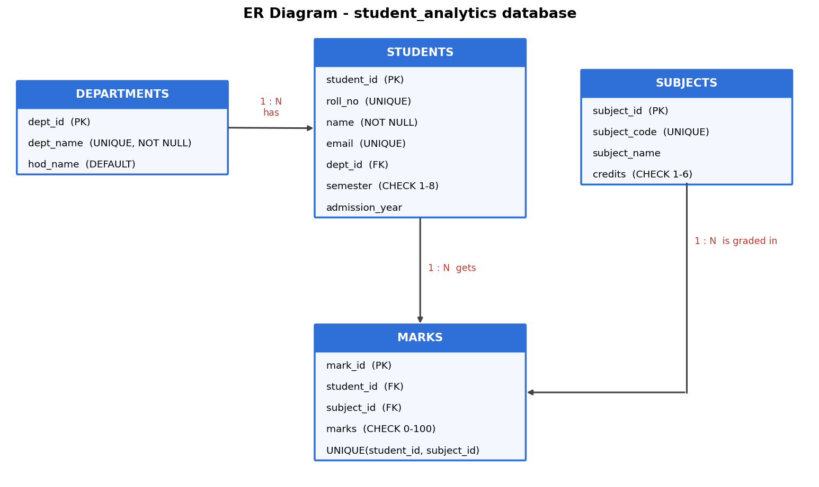
PART A · DESIGN
ER diagram and normalization
Why 3NF?
1NF atomic values, a primary key in every table
2NF marks depends on the whole key (student, subject)
3NF department name stored only in departments, so no transitive dependency
Student Performance Analytics System · Part A
Notes:
Walk through the ER diagram: one department has many students, one student has many marks, one subject has many marks. Then explain why it is in 3NF (viva question).

Slide 6
PART A · DESIGN
Tables and constraints
Table | Key columns | Constraints used
departments | dept_id, dept_name, hod_name | PK; dept_name NOT NULL + UNIQUE; hod_name DEFAULT
subjects | subject_id, subject_code, credits | PK; subject_code UNIQUE; credits CHECK 1-6
students | student_id, roll_no, email, dept_id, semester | PK; email UNIQUE; FK dept_id; semester CHECK 1-8
marks | mark_id, student_id, subject_id, marks | FK x2; marks CHECK 0-100; UNIQUE(student, subject)
Rules enforced: marks 0-100, one mark per student per subject, semester 1-8, unique e-mail.
Student Performance Analytics System · Part A
Notes:
Point out that every constraint type is used at least once: PK, FK, NOT NULL, UNIQUE, CHECK, DEFAULT.

Slide 7
PART A · SQL
Five JOIN queries
Query | What it answers | Key SQL feature
(a) | Marks with student, department and subject name | 3 INNER JOINs
(b) | Subject-wise average, highest, lowest | GROUP BY + AVG / MAX / MIN
(c) | Department-wise topper | CTE + RANK() OVER (PARTITION BY)
(d) | Students failing at least one subject (< 40) | WHERE + GROUP_CONCAT
(e) | Department average, even with no students | LEFT JOIN
Result of (e): Computer Science 68.96 · Electronics 66.31 · Civil 65.19 · Mechanical 64.07 · Biotechnology NULL (no students)
Student Performance Analytics System · Part A
Notes:
Demo tip: run query (e) in Workbench and show Biotechnology with a NULL average. That is the difference between LEFT JOIN and INNER JOIN.

Slide 8
PART A · SQL
Stored functions and constraint tests
Rule tested | MySQL error
CHECK marks = 150 | 3819: Check constraint 'chk_marks_range' is violated
Duplicate mark entry | 1062: Duplicate entry '1-1' for key 'uq_student_subject'
Unknown department | 1452: foreign key constraint fails
NULL student name | 1048: Column 'name' cannot be null
Stored functions
get_grade(marks)
get_percentage(student_id)
get_result(student_id) - PASS / FAIL (bonus)
A+ >= 90, A >= 80, B+ >= 70, B >= 60, C >= 50, D >= 40, F < 40
Student Performance Analytics System · Part A
Notes:
All six error messages are real MySQL 8 output. Each INSERT was meant to fail and it did.

Slide 9
02
PART B
Python analysis
CSV files, Pandas, NumPy, Matplotlib and the menu program.
Notes:
Part B: everything in Python. No database connection is needed.

Slide 10
PART B · WORKFLOW
From database to charts
1
2
3
4
5
6
Export
Load
Merge
Clean
Analyse
Present
4 tables to CSV
pd.read_csv()
pd.merge = JOIN
dups, numbers, fill mean
NumPy, pivot, grade, rank
charts + menu
pd.merge(marks, students, on="student_id") == marks JOIN students ON student_id
Student Performance Analytics System · Part B
Notes:
Say that pd.merge is the Pandas version of a SQL JOIN. It matches rows on a key column exactly like JOIN ... ON.

Slide 11
PART B · CODE
Project files and functions
File | Main functions
data_handler.py | load_data(), save_marks(), merge_tables()
analysis.py | clean_data(), subject_stats_numpy(), build_student_report(), department_average(), at_risk_students()
charts.py | bar_subject_average(), pie_grades(), histogram_marks(), box_department_percentage()
main.py | menu, read_int(), read_marks(), add_or_update_marks(), export_report()
Grades use np.select (vectorised if / elif / else). Rank uses rank(method="min"). Status is FAIL if any subject is below 40.
Student Performance Analytics System · Part B
Notes:
Code is split into small functions with no repeated code, as the assignment requires.

Slide 12
PART B · ANALYSIS
NumPy and Pandas results
Subject | Mean | Median | Std dev
Data Structures | 69.70 | 70.5 | 16.08
Database Mgmt | 67.53 | 68.5 | 15.37
English | 67.20 | 70.5 | 15.72
Physics | 66.23 | 66.5 | 17.41
Mathematics | 65.03 | 67.0 | 16.00
Python Programming | 61.70 | 61.0 | 14.50
24 / 6
PASS / FAIL students
7
at-risk students (below 50% or a fail)
85.33%
topper: Vedant Gaikwad (Civil)
Student Performance Analytics System · Part B
Notes:
Mention that the Pandas department averages equal the SQL query (e). Mean vs median: close values mean the marks are roughly symmetric.

Slide 13
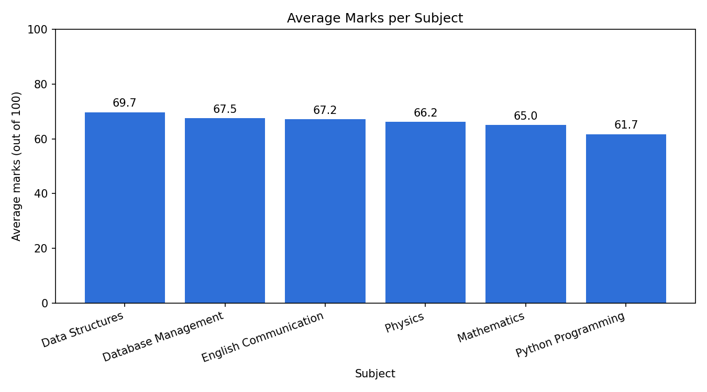
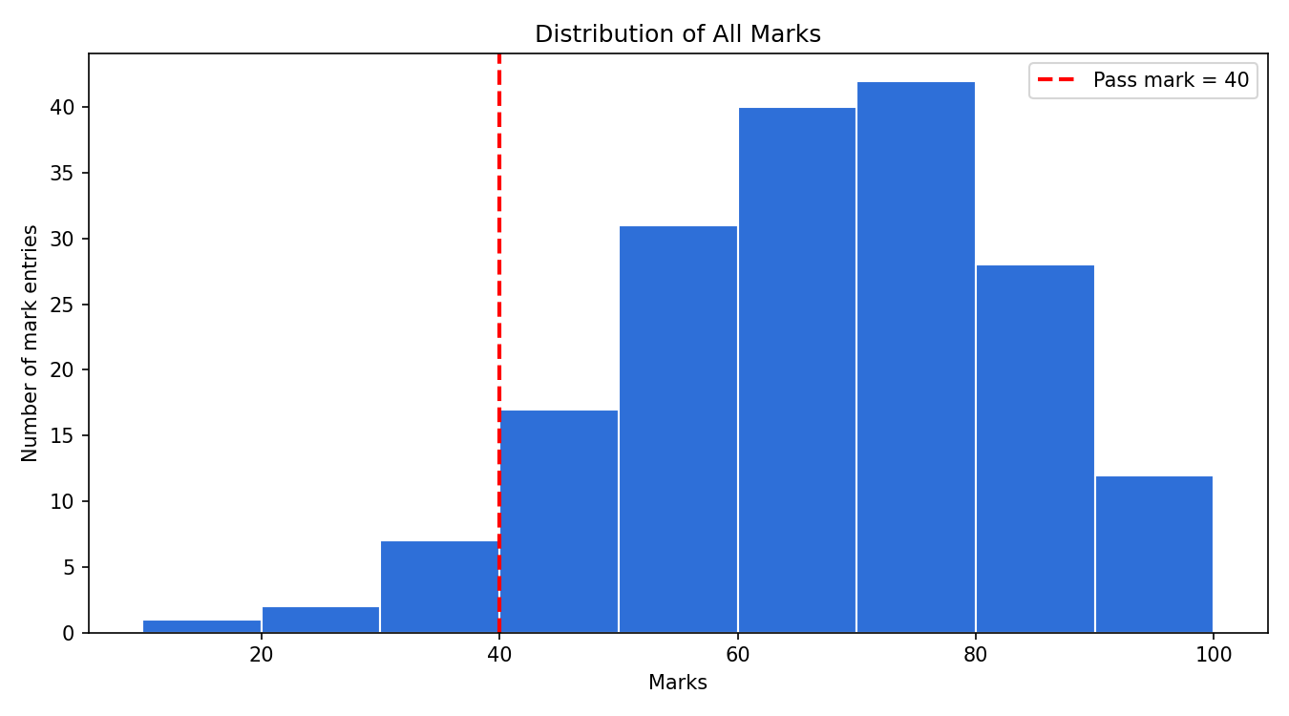
PART B · CHARTS
Average marks and mark distribution
Data Structures has the highest average (69.7) and Python Programming the lowest (61.7), a gap of only 8 marks.
Most marks lie between 50 and 90. Only 10 of 180 entries fall below the pass mark of 40.
Student Performance Analytics System · Part B
Notes:
Bar chart: Data Structures is highest, Python lowest. Histogram: the red line is the pass mark 40; only 10 of 180 entries are to its left.

Slide 14
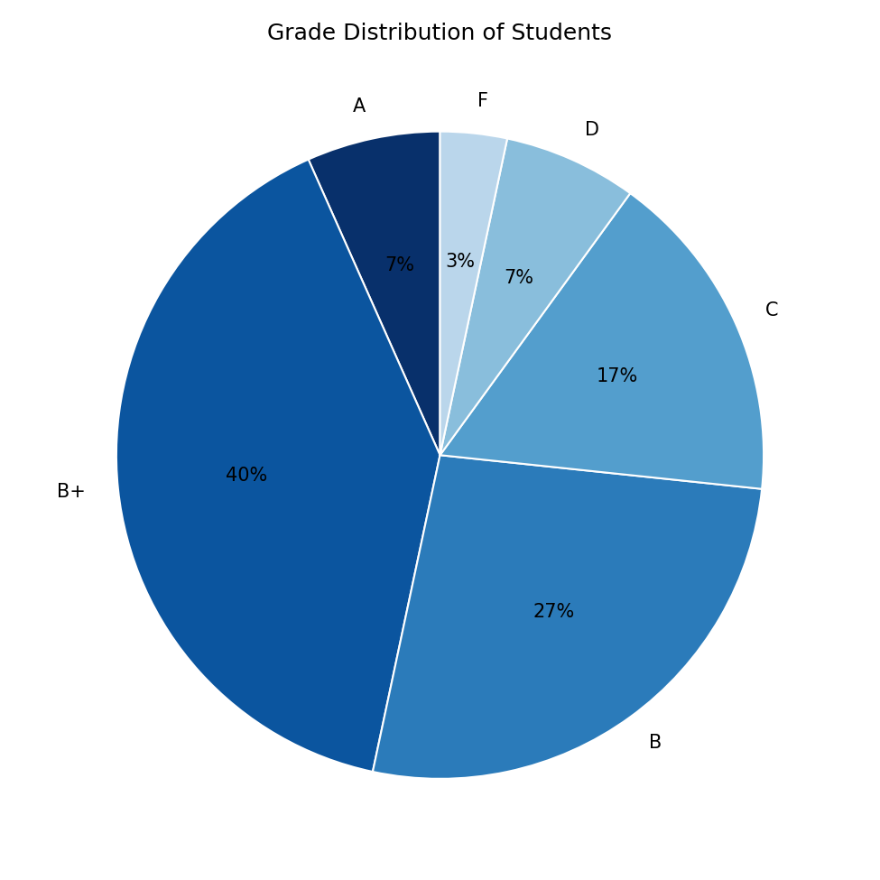
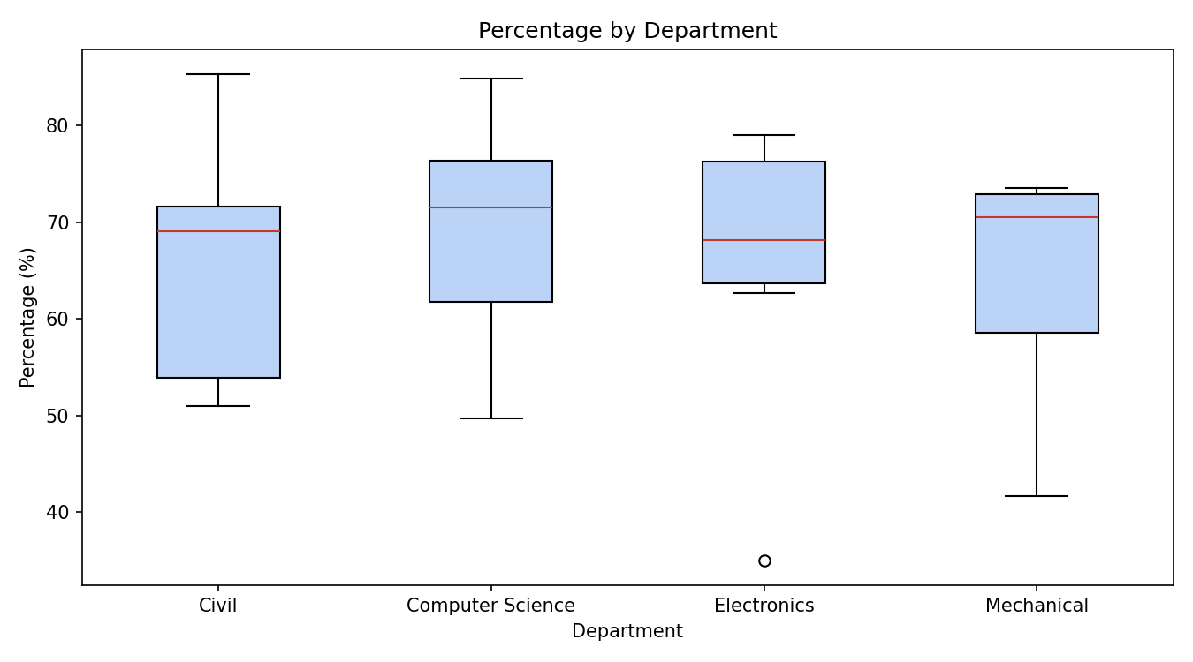
PART B · CHARTS
Grades and department comparison
B+ is the most common grade (12 of 30 students). Only 2 students got A and 1 got F.
Department medians are close (about 68-72%). Civil and Computer Science contain the highest scorers.
Student Performance Analytics System · Part B
Notes:
Box plot shows median, quartiles, spread and outliers in one picture. Electronics has one low outlier student.

Slide 15
PART B · PROGRAM
Menu-driven program with validation
Menu in main.py
Input validation
1 Add / update marks
2 View student report
3 Show topper list
4 Show analysis
5 Show charts
6 Export report to CSV
0 Exit
Numbers only (try / except ValueError)
Marks must be between 0 and 100
Student and subject must exist
FileNotFoundError and PermissionError handled
read_marks(): keep asking until 0 <= value <= 100
Student Performance Analytics System · Part B
Notes:
Demo: type letters, then 150 as marks, and show that the program rejects them and asks again.

Slide 16
WRAP-UP
Demo and conclusion
5-minute demo
What I learned
1. Run project.sql, show query (e)
2. python main.py, option 2: student report
3. Option 1: marks 150 is rejected
4. Options 3 and 4: toppers and analysis
5. Options 5 and 6: charts and CSV export
Normalization and constraints, JOINs and stored functions, pd.merge = JOIN, NumPy statistics, Matplotlib charts, input validation.
Next: attendance correlation (np.corrcoef), semester line chart, a web dashboard.
Thank you. Questions?
Student Performance Analytics System · Part B
Notes:
Finish with the demo flow, then invite questions. Viva answers are in docs/Viva_QA.md.

